Slide 1

Customer Shopping Behavior Analysis
An End-to-End Data Analysis Project

Slide 2
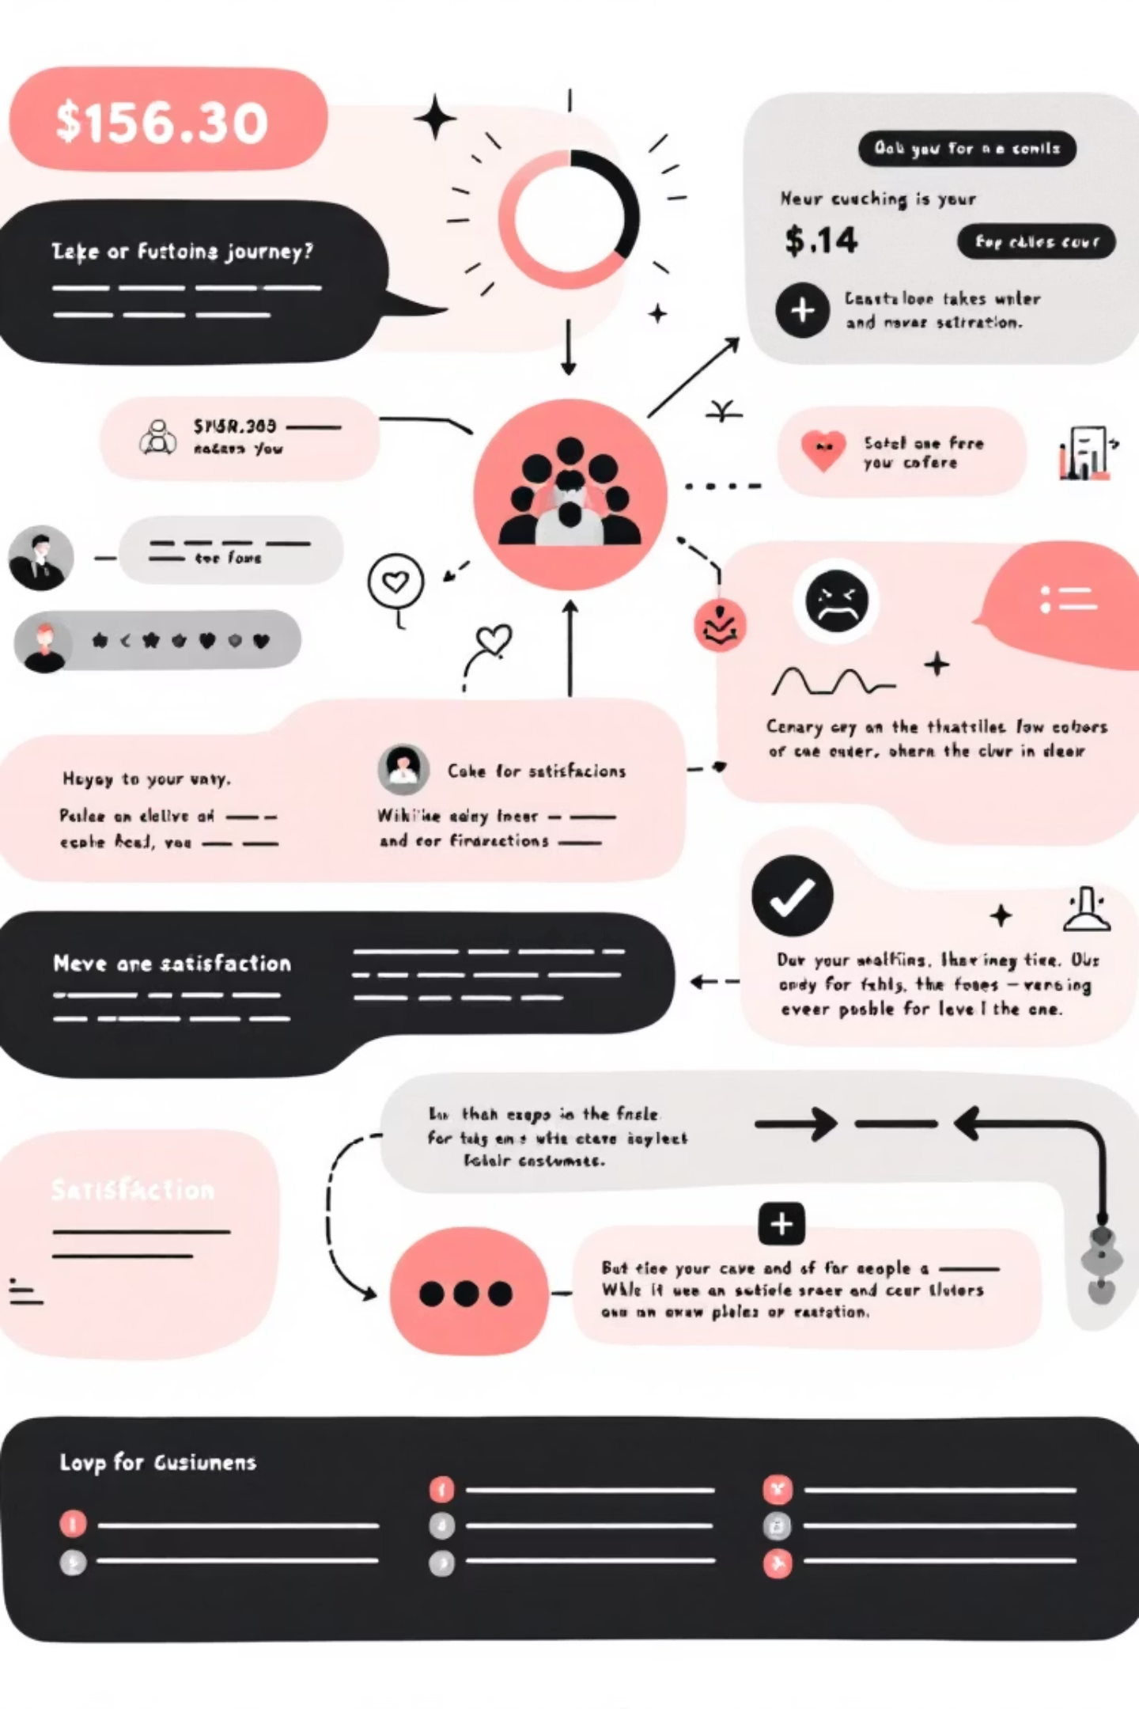
Project Overview
Understanding customer behavior is key to success.
Improve Sales
Optimize Marketing
Optimize strategies.
Enhance efforts.
Enhance Experience
Boost customer satisfaction.

Slide 3




Project Workflow
Data Prep
Python cleaning & preparation.
Data Modeling
MySQL relational tables & queries.
Visualization
Power BI interactive dashboard.

Slide 4

Data Cleaning & Preparation
Using Python
Standardize
Handle Missing
Export Cleaned Data
Column names.
Values effectively.
To MySQL.

Slide 5
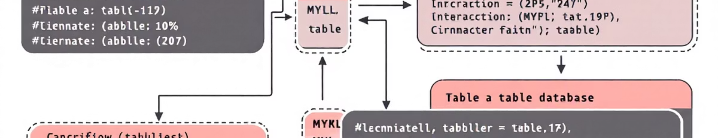
Data Modeling & Analysis
Key MySQL Insights
Revenue by Gender
Top 5 Products by Rating
Male: $157,890
Gloves: 3.86
Female: $75,191
Sandals: 3.84
Boots: 3.82

Slide 6

More MySQL Insights
Shipping Type Comparison
Subscribers vs. Non-Subscribers
Standard: $58.46 avg.
Subscribers: $59.49 avg. spend
Express: $60.48 avg.
Non-Subscribers: $59.87 avg. spend

Slide 7
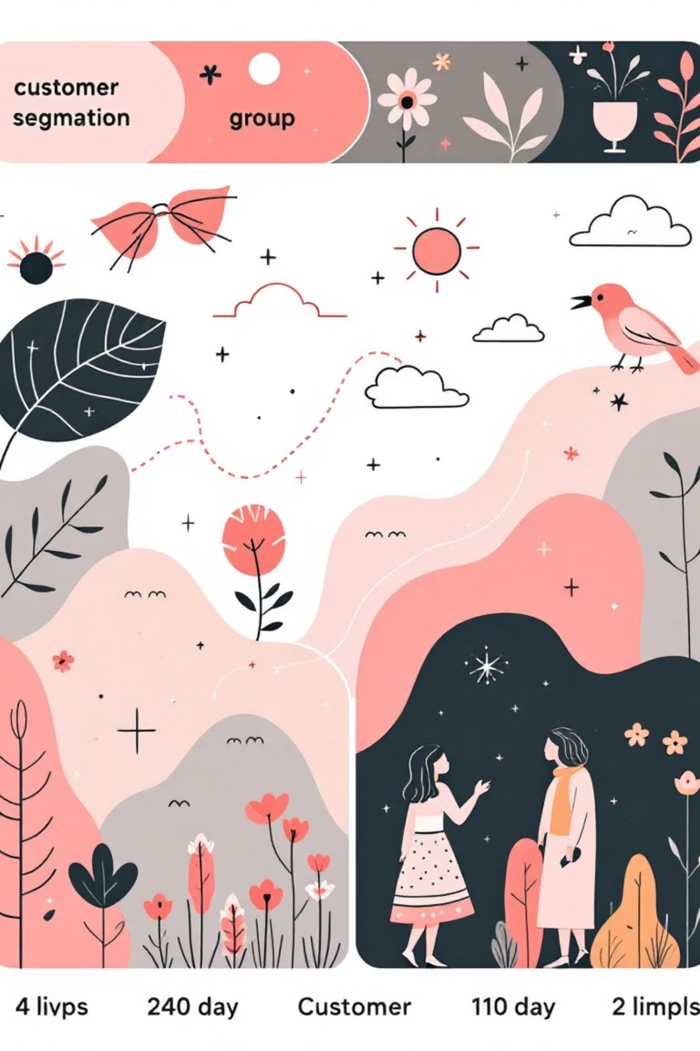

Customer Segmentation
New
Returning
83 Customers
701 Customers
Loyal
3116 Customers

Slide 8
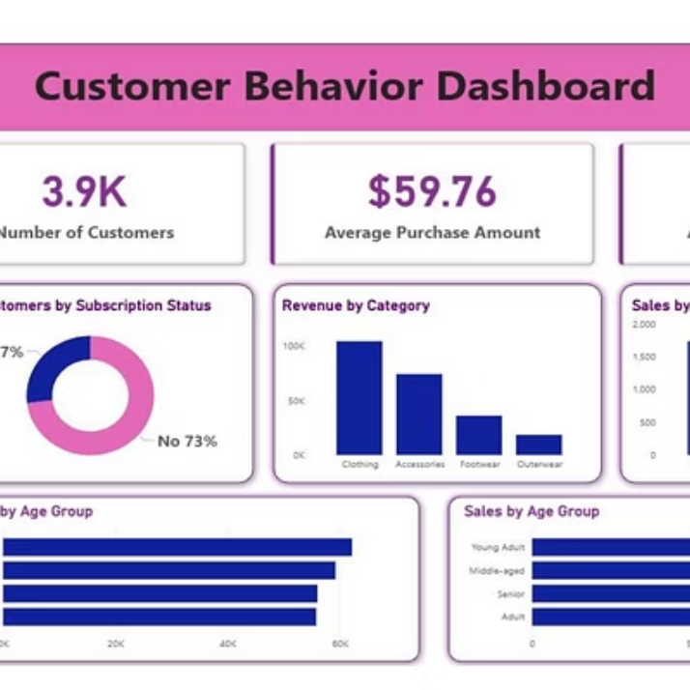
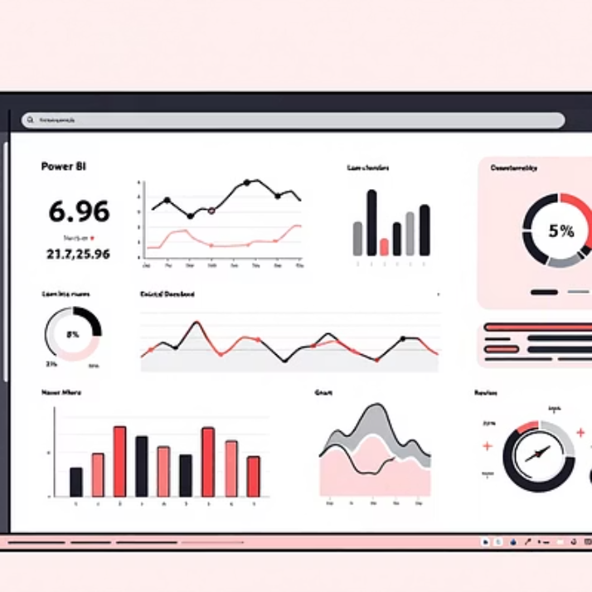
Power BI Dashboard
Interactive visualizations for deeper understanding.

Slide 9
Key Insights
1
2
3
Winter Season
Clothing Category
Credit Card Users
Highest order volume.
Most revenue.
Spend more.
4
5
High-Rated Products
Women's Spending
Better retention.
Slightly higher.

Slide 10

Business Recommendations
Increase Winter Inventory
Targeted promotions.
Focus Marketing
High-performing categories.
Rewards for Buyers
Frequent purchases.
Improve Credit Card
Payment experience.

